Slide 1







Enterprise Blockchain Developers (Intermediate)
In support of
Powered By

Slide 2
Outline
What is Open Ethtereum
Chain Specifications
Permissioning
Code Demo
© 2017-2020 SmartMesh Foundation Pte. Ltd. | MeshBox Foundation Pte. Ltd.

Slide 3
What is Open Ethtereum
Fast and feature-rich multi-network Ethereum client.
Features:
Pluggable Consensus: POW, POA, AURA(Authority Round), Private China
Custmized Promission via Smart Contracts
Chain specification
https://github.com/openethereum/openethereum/tree/cb0513a8b1df42bef218e05a880ecd3fbc8ec413/ethcore/res

Slide 4
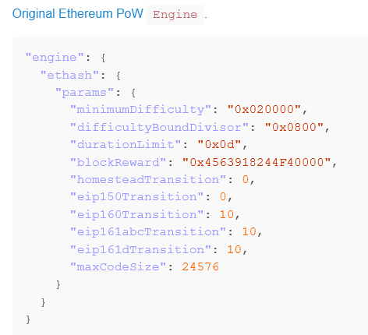
Chain Specifications

Slide 5
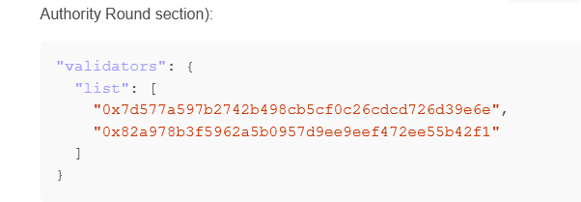
Chain Specifications

Slide 6
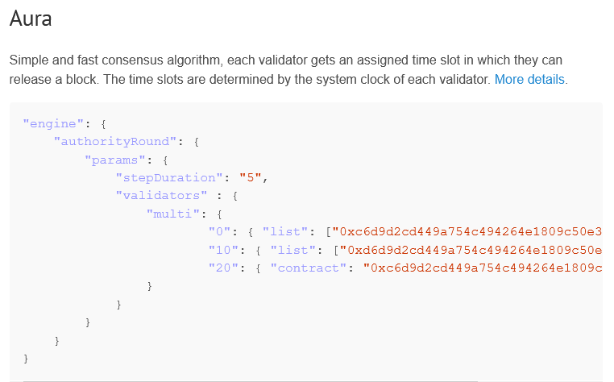
Chain Specifications
This is a hard fork. (Code Demo)

Slide 7
Permissioning
https://github.com/openethereum/kovan-validator-set/tree/master/contracts
we introduce permissions on a number of different layers:
Network
Transaction type
Validator set
Gas price
Private transactions
(Code Demo)

Slide 8
Code Demo
reference:
https://openethereum.github.io/

